Slide 1
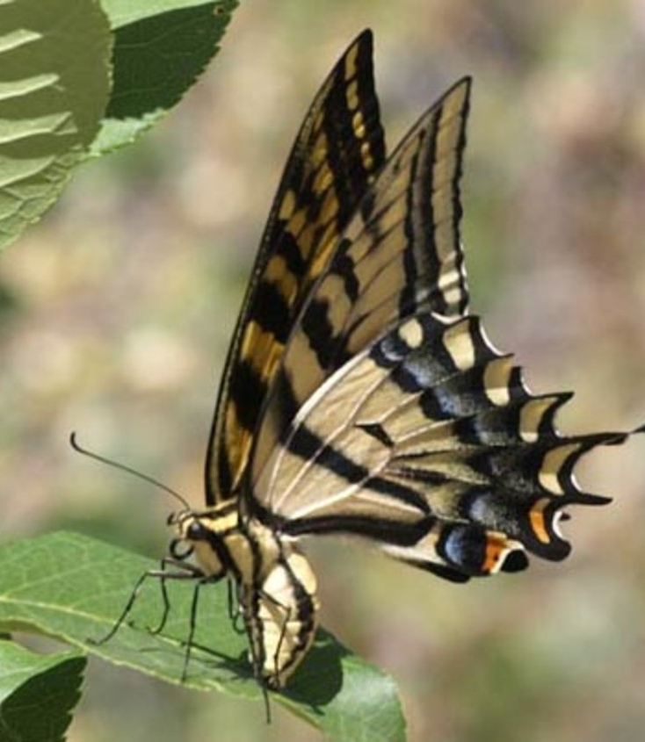
The Willow Bend Butterfly Mural and Pollinator Pathways Project

Slide 2
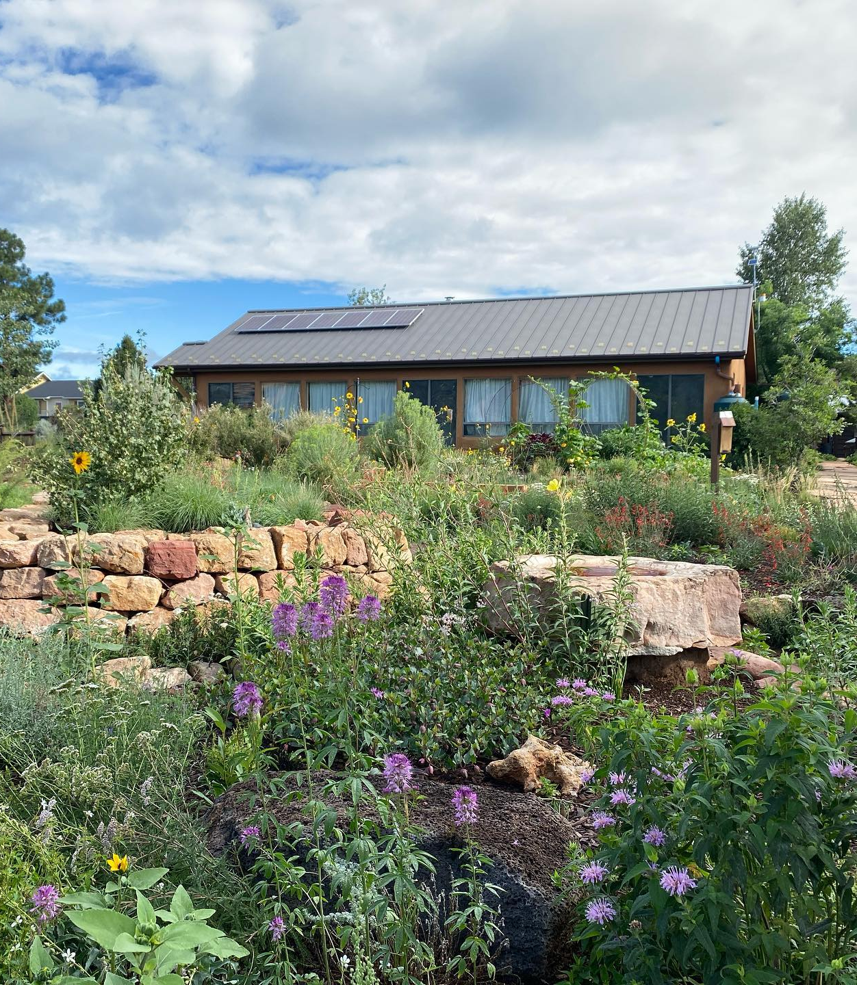
Background:
Willow Bend is a 501 (c) (3) non-profit organization providing environmental programs for the greater Flagstaff area.
We are located in Sawmill Park, a county island within the City of Flagstaff. Surrounded by habitat gardens that are free and open to the public 24/7.
We are adjacent to NAU and CCC, local schools, Boys and Girls Club, the Juvenile Detention Center, and the Southside community.
In 2017 we received a Heritage Grant to restore the habitat gardens and add new interactive and ADA accessible features.

Slide 3
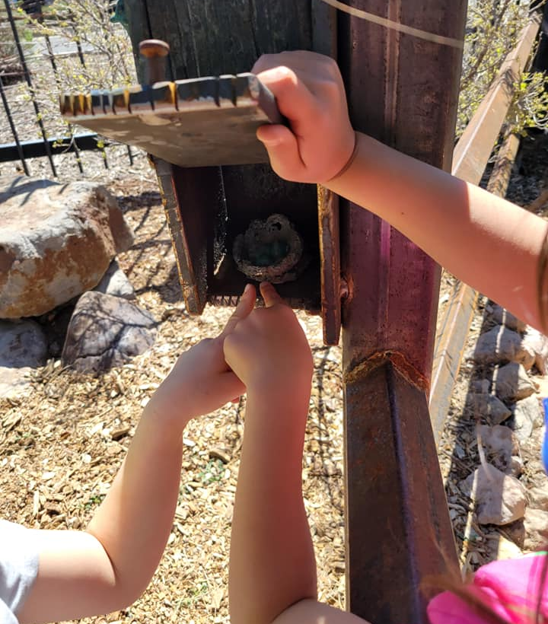
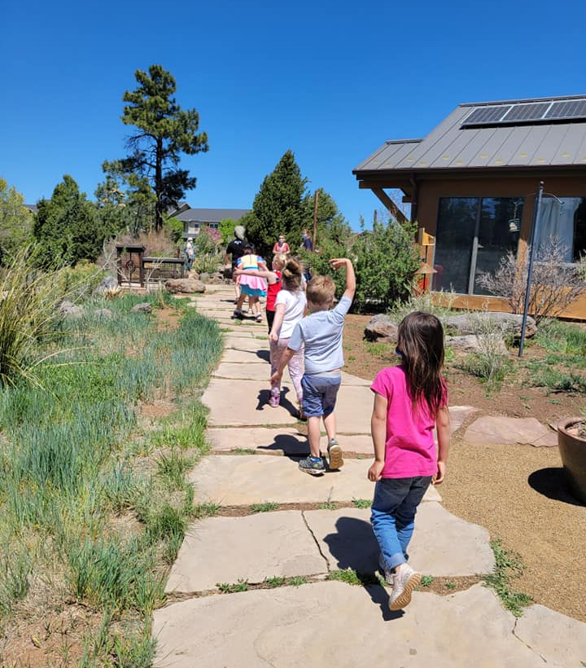
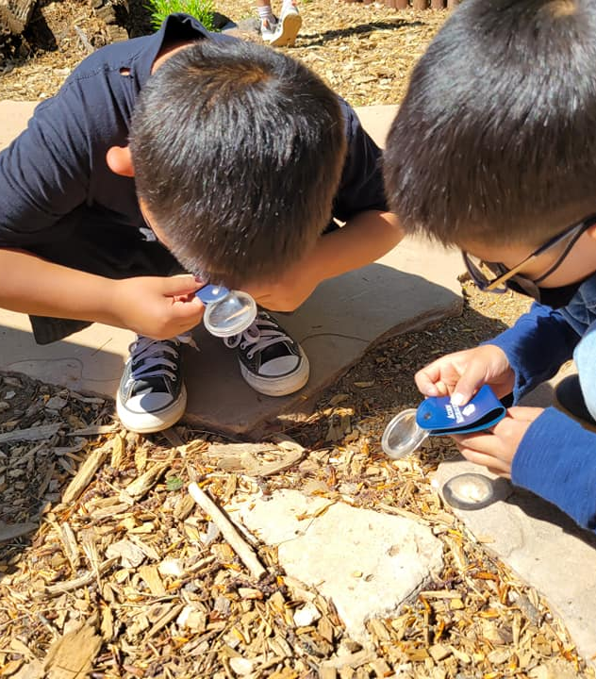
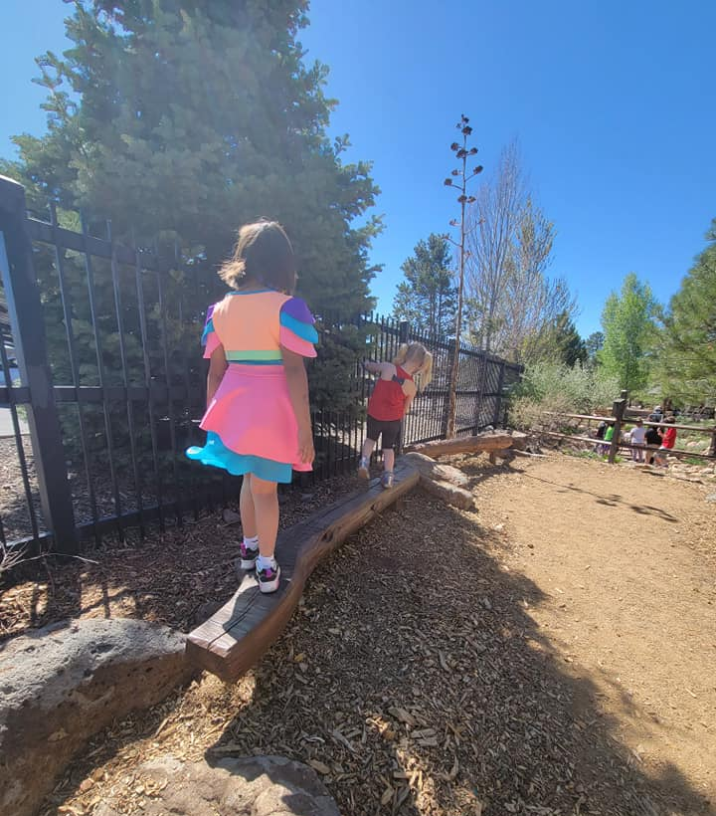
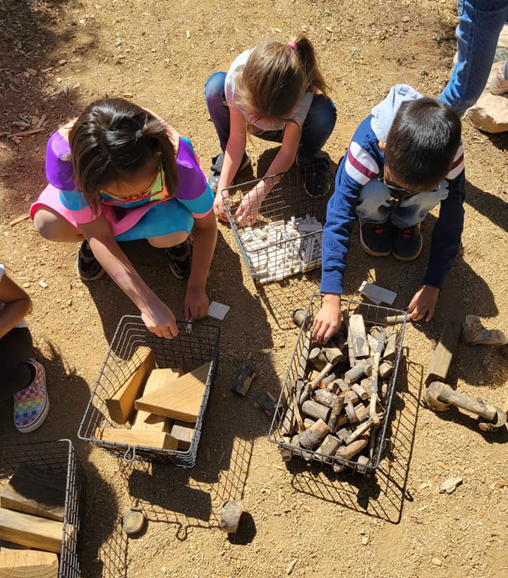
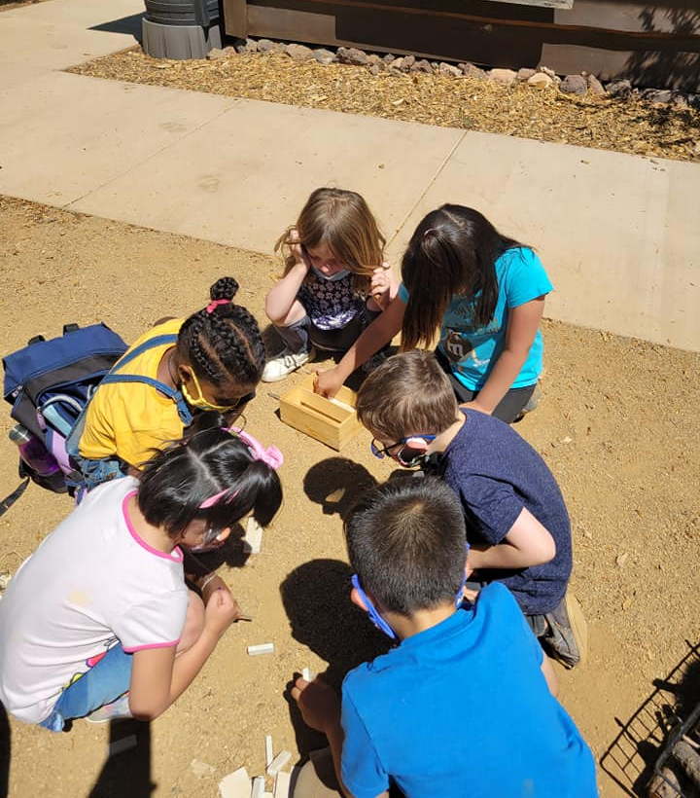
The Outdoor Classroom
An ADA accessible garden that provides an opportunity for the community to learn about wildlife through fun educational activities including the tactile baskets, the “hide and go seek” bronze animals, a log balance beam, use of magnifying glasses, and more.

Slide 4
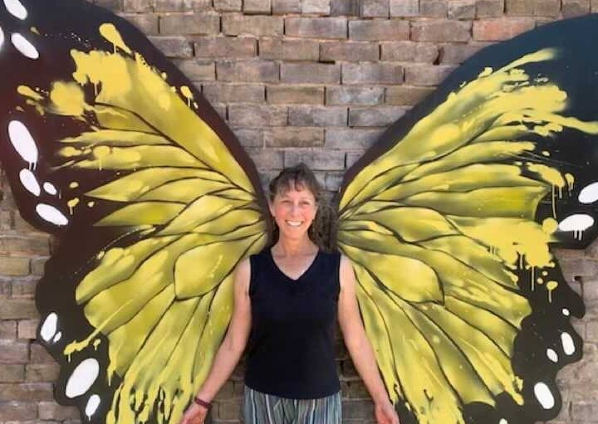
The Mural
The mural will be added to the outdoor classroom, painted on the south facing shed.
The two-tailed swallow tail is the AZ state butterfly. The mural will be interactive providing an opportunity for visitors to be part of the butterfly and experience themselves with its wings.
The mural will also include pollinator facts (yet to be designed).

Slide 5
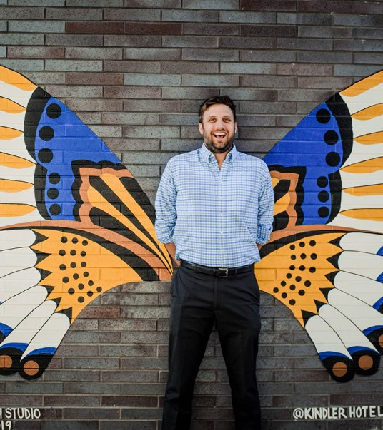
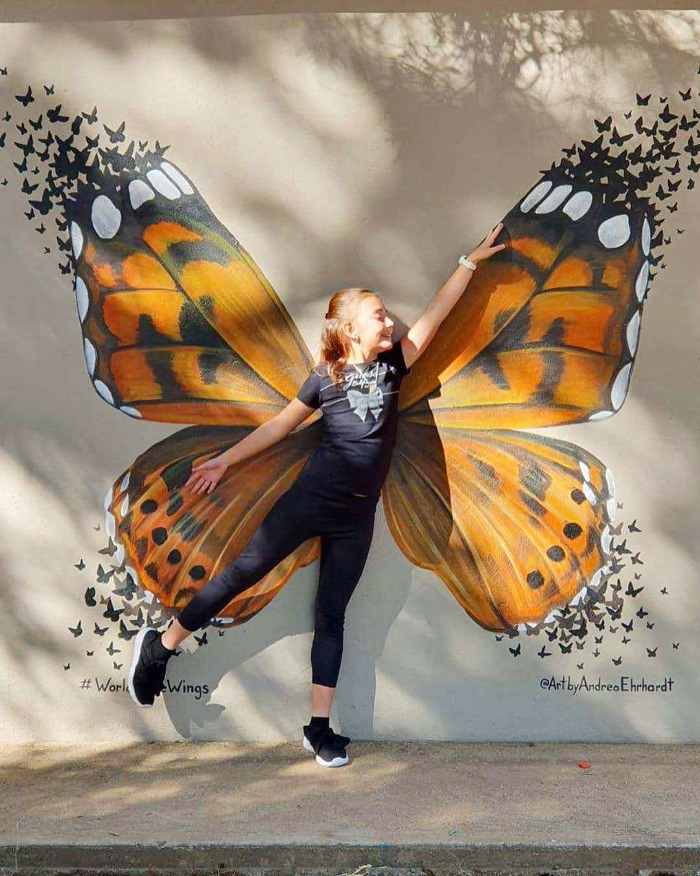

Slide 6
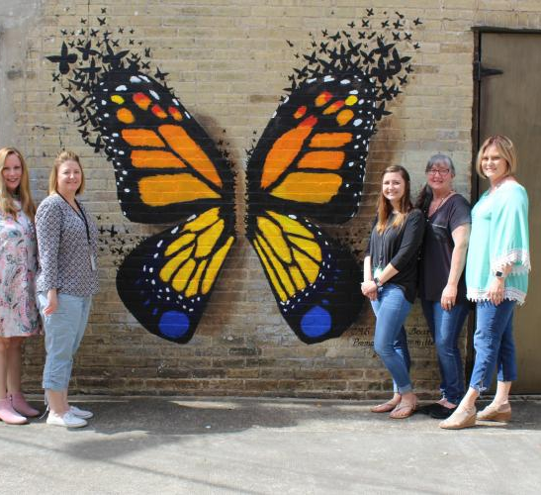

Slide 7
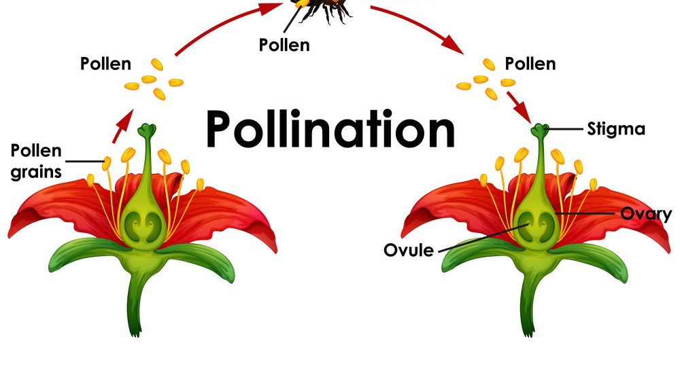
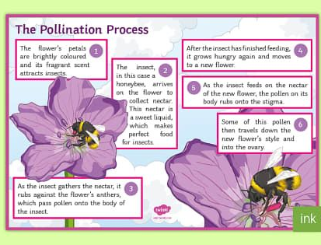

Slide 8
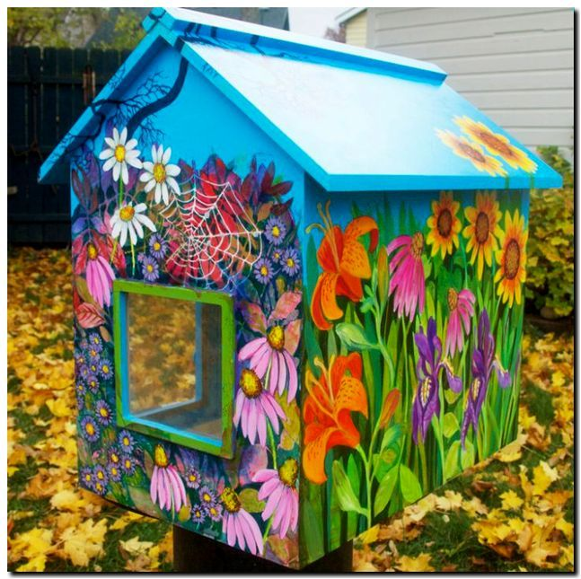
Pollinator Pathways: The Free Little Library and Pollinator Activities
A colorful free little library will be placed in the garden.
The library will have pollinator, native plants, and nature art focused books.
Other features include interactive pollinator bingo, pollinator information and habitat garden brochures, insect identification cards, insect hotels, and outdoor pollinator games and art activities

Slide 9
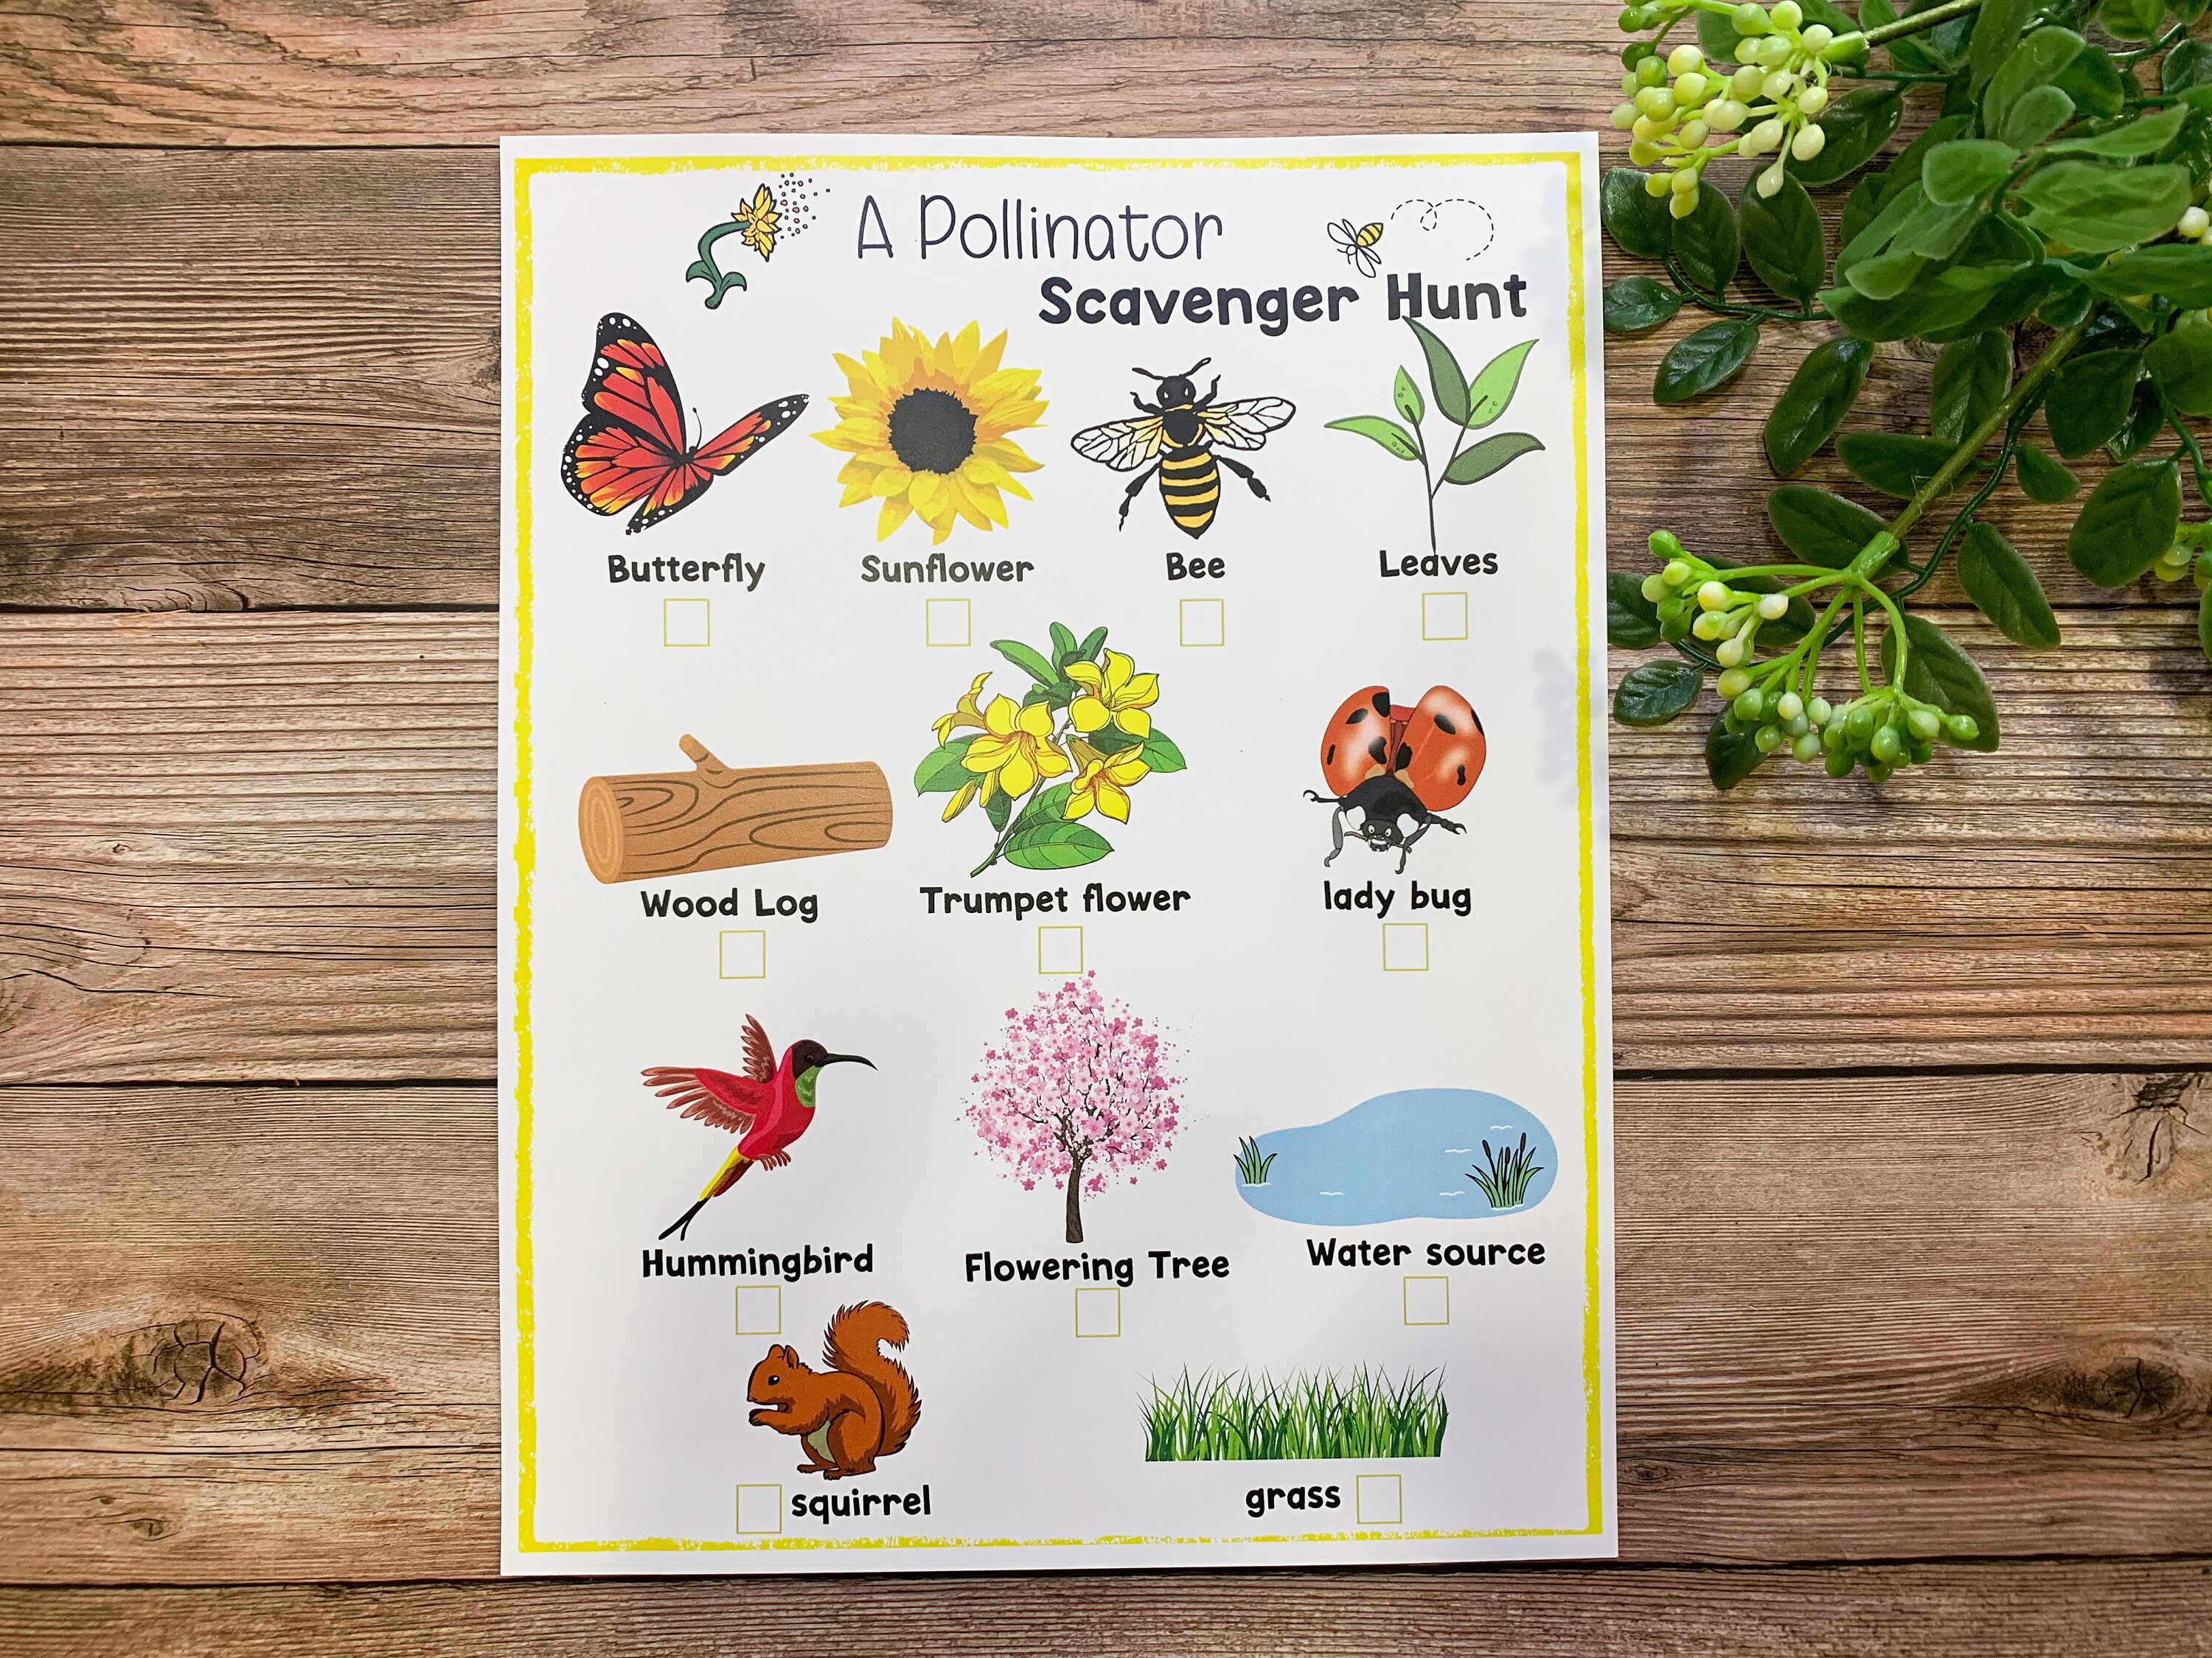
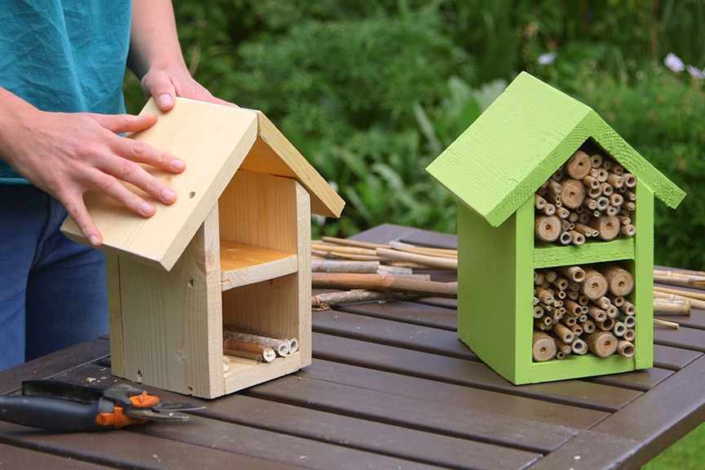
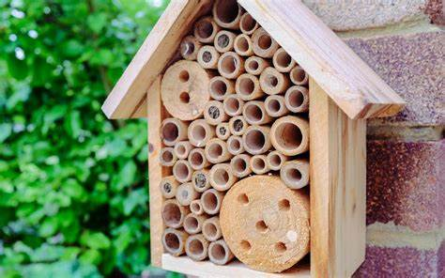
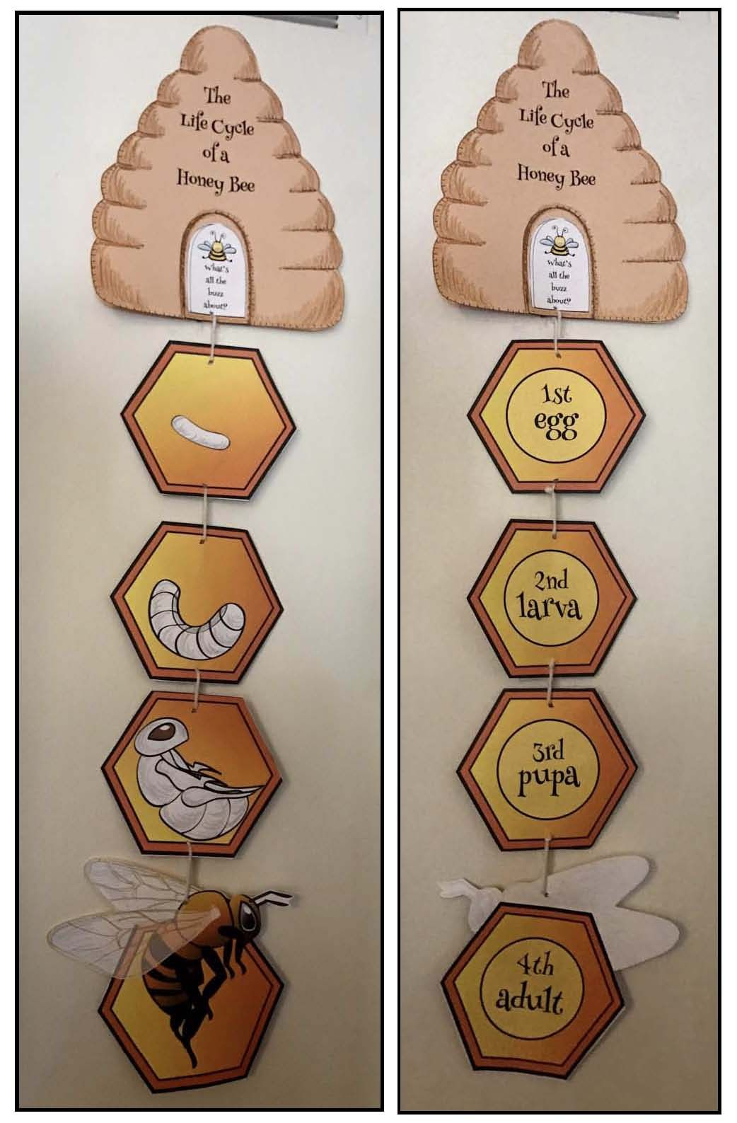
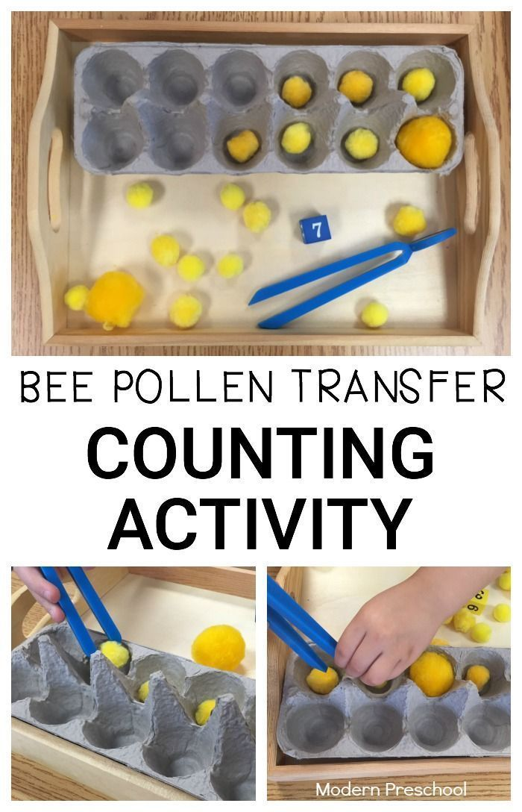
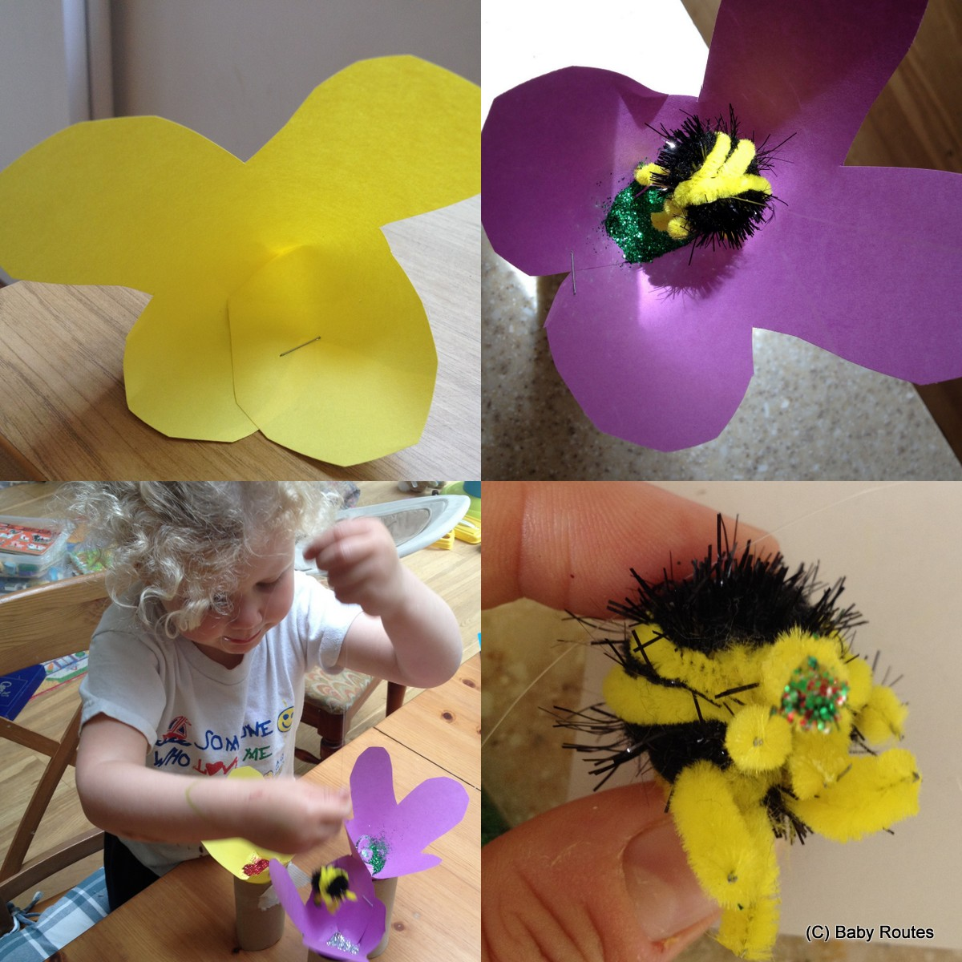
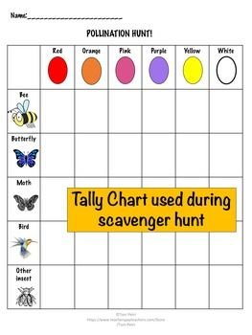

Slide 10
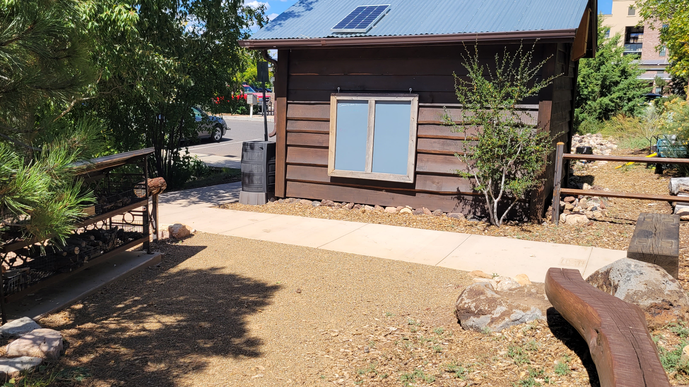
Free little library
Mural Location
Pollinator facts around the butterfly

Slide 11
Questions?

Slide 12
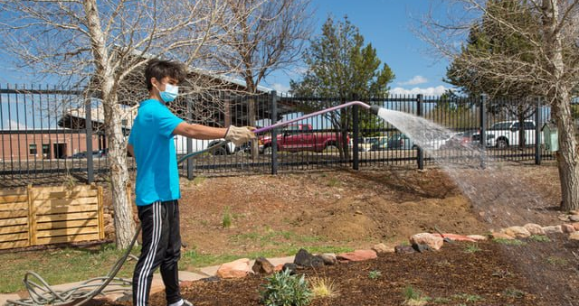
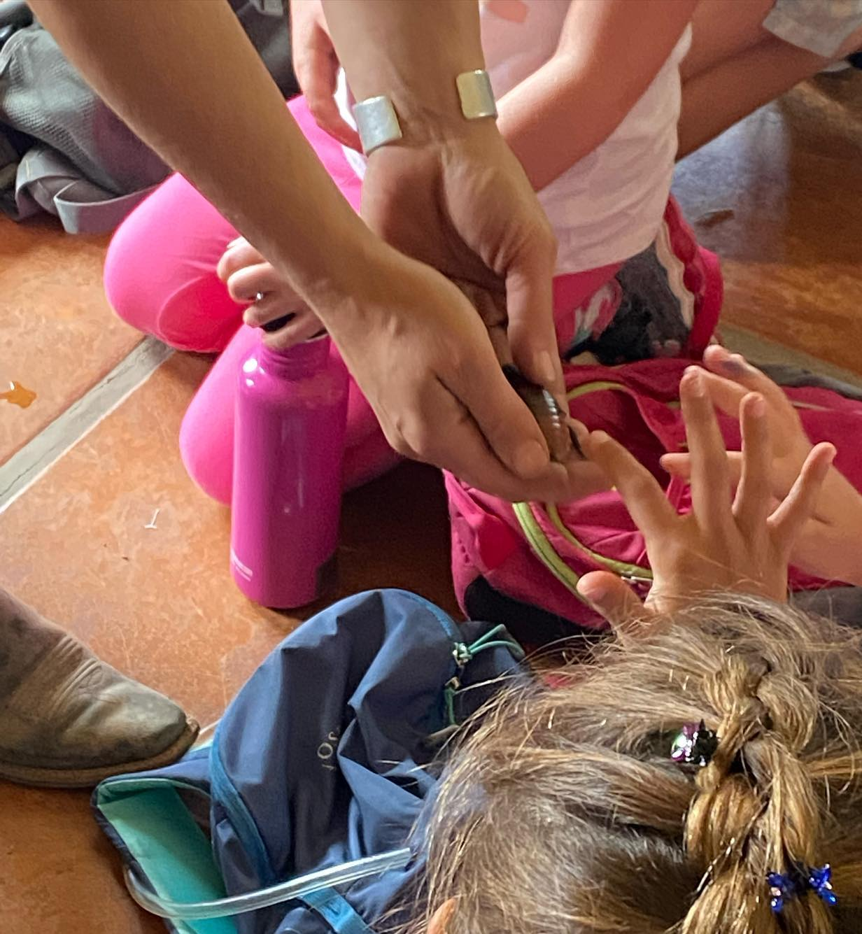
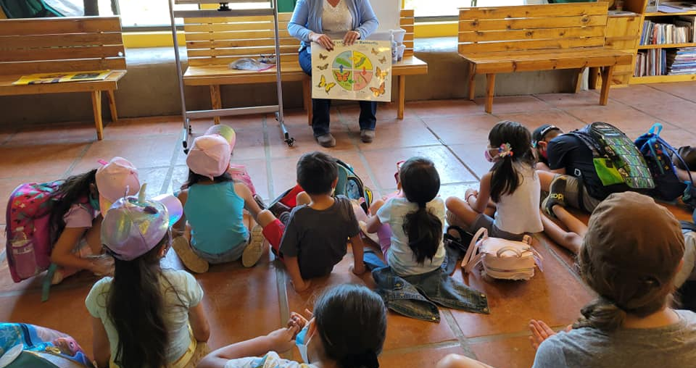
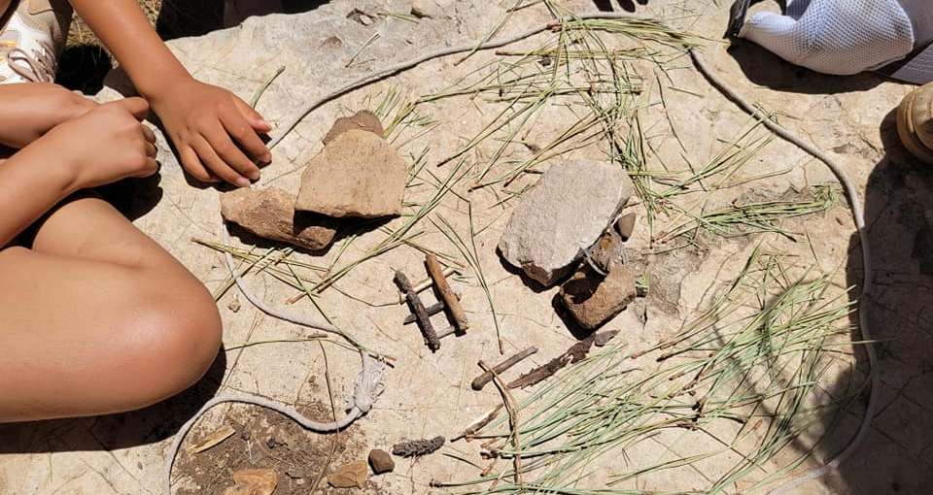
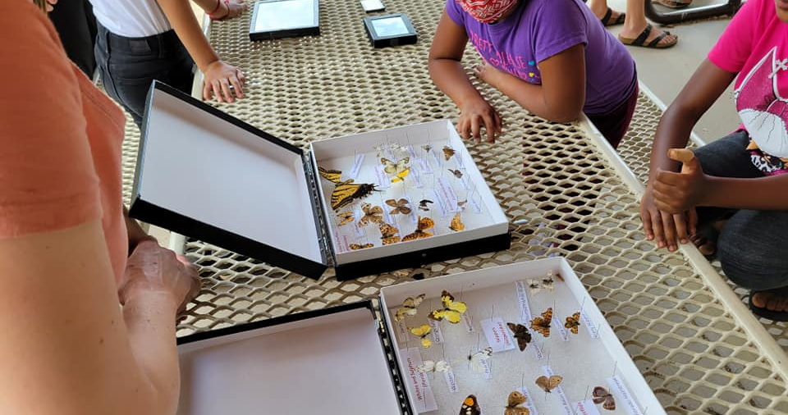
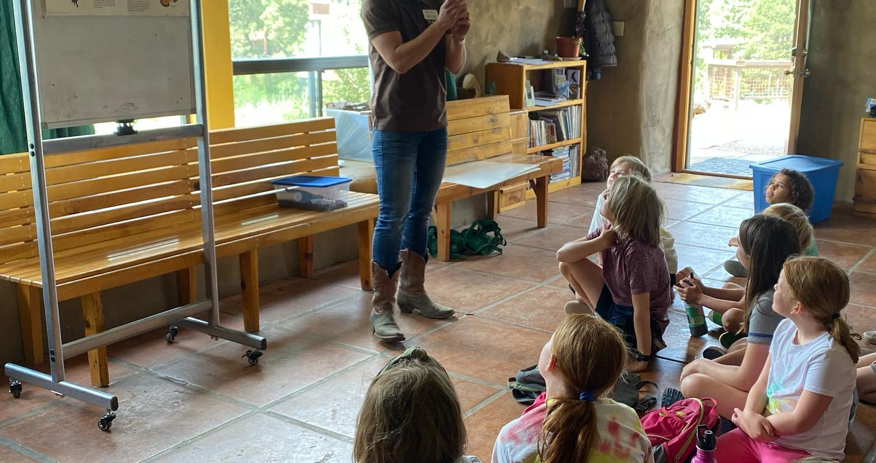
THANK YOU!

